Slide 1

Lectures, Slides, & Q&A
Lecture slides with audio:
Activity flow
<https://github.com/braddelong/public-files/blob/master/econ-115-module-0-lecture-1-activities-%23tceh.pptx>
The educational process
Dasgupta’s take on economics
Logistics
Link
Link

Slide 2

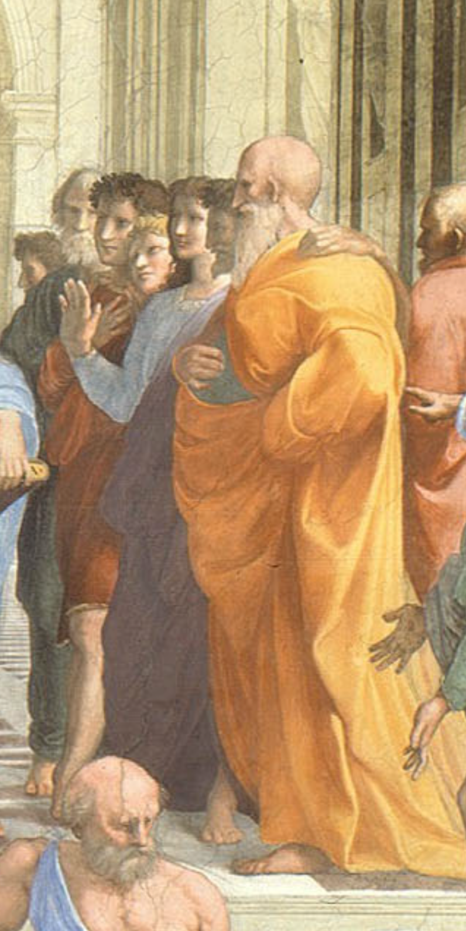

Lecture: Sokrates vs. Machiavelli on the Educational Process
Machiavelli:
I… put on the garments of court and palace… step inside the venerable courts of the ancients, where, solicitously received by them, I nourish myself on that food that alone is mine and for which I was born; where I am unashamed to converse with them and to question them about the motives for their actions, and they, out of their human kindness, answer me. And for four hours at a time I feel no boredom, I forget all my troubles, I do not dread poverty, and I am not terrified by death…
Niccolo Machiavelli (1513): Letter to Francesco Vettori <https://github.com/braddelong/public-files/blob/master/readings/letter-machiavelli-vettori.pdf>
Sokrates:
The creations of the painter have the attitude of life, and yet if you ask them a question they preserve a solemn silence…. [Words] once written down they are tumbled about anywhere among those who may or may not understand them, and know not to whom they should reply, to whom not… and they cannot protect or defend themselves…. Would a husbandman… take the seeds… and in sober seriousness plant them during the heat of summer?… The serious pursuit of the dialectician… finding a congenial soul, by the help of science sows and plants therein words which are able to help themselves… and have in them a seed which others brought up in different soils render immortal, making the possessors of it happy to the utmost extent of human happiness…
Plato (-370): Phaedrus <https://github.com/braddelong/public-files/blob/master/readings/book-plato-phaedrus.pdf>
3:00 of audio in this slide; 9:30 in this slide group
Notes:
On the slide are two substantial quotes about the experience and utility of reading books for education. One was written in the early 1500s by intellectual, bureaucrat, and statesman Niccolo Machiavelli of the republic of Florence, Italy. The other was written down in the early -300s by the philosopher Plato of the Republic of Athens, Greece, reporting or claiming to report the words of his teacher Sokrates. Pause this audio track, read the two quotations, and think about them.
Machiavelli, as portrayed by himself, and Sokrates, as portrayed by Plato, have diametrically opposed views of the usefulness of books. For Machiavelli, a book is almost as good as being there with the author—indeed, books are better, because Machiavelli in his library has many authors, all at his beck and call. Sokrates, by contrast, appears to think that books are very likely to be misread and misinterpreted: “they cannot defend themselves", "they do not know to whom they should reply, to whom not”.
For Sokrates, real education is only conducted by a teacher skilled in the art of dialectic—of getting a true dialogue going that leads the student to think for themself and thus have planted in their brain “words which are able to help themselves”, which will then “make the possessors… happy to the utmost extent of human happiness”.
Machiavelli, by contrast, thinks that education is accomplished by simply throwing somebody with leisure to read into a library.
For most people almost all of the time, for some people most of the time, and for all people at least some of the time, Sokrates was right: it is hard work to learn anything but the most partial and evanescent knowledge from books. That was the point of the Andy Matuschak reading—and I hope you got that point, although right now I am wondering if starting this course by asking you to learn something by reading an article was a smart thing for me to have done.
Andy Matuschak has ideas about how to reorganize and restructure books to make reading easier, or at least better from an educational point of view. And—his complaints about university courses that consist of badly taught lectures aside—I think it is fruitful to think of universities-as-institutions as scaffoldings and support systems to make deep and durable learning from books and other media easy, or easier, or at least possible: although you cannot lead a horse to water, you cannot make them drink if they do not want to.
We now face the problem of reproducing what makes a university work—what makes students at a well-functioning university more like Machiavellis and less like the hapless students of Sokrates, who are able to learn only through the deep, focused, personal attention of one of the greatest minds known to us in human history.
How are we going to manage to accomplish this?
——
Lecture: Sokrates vs. Machiavelli on the Educational Process
Machiavelli:
I… put on the garments of court and palace… step inside the venerable courts of the ancients, where, solicitously received by them, I nourish myself on that food that alone is mine and for which I was born; where I am unashamed to converse with them and to question them about the motives for their actions, and they, out of their human kindness, answer me. And for four hours at a time I feel no boredom, I forget all my troubles, I do not dread poverty, and I am not terrified by death…
Sokrates:
The creations of the painter have the attitude of life, and yet if you ask them a question they preserve a solemn silence…. [Words] once written down they are tumbled about anywhere among those who may or may not understand them, and know not to whom they should reply, to whom not… and they cannot protect or defend themselves…. Would a husbandman… take the seeds… and in sober seriousness plant them during the heat of summer?… The serious pursuit of the dialectician… finding a congenial soul, by the help of science sows and plants therein words which are able to help themselves… and have in them a seed which others brought up in different soils render immortal, making the possessors of it happy to the utmost extent of human happiness…

Slide 3

Our Difficult Task
How do we duplicate—online—the “active learning” components that the in-person university does as a matter of course?:
MOOCs did not cut it…
The people who could learn from MOOCs are the Machiavellis—the people who turn their books into sub-Turing class instantiations of the books’ authors, and have conversations with them
Thus a MOOC, for those who could learn effectively from it, was little better than and a lot more expensive than a book
We need a plan for those of you—which is most of us—who are not Machiavellis, but rather like Sokrates’s students
People who really need a tutorial…
A professor, a GSI, a roommate, a classmate, a study group…
2:45 audio
Notes:
How do we duplicate—online—the “active learning” components that the in-person university does largely as a matter of course, and that truly skilled readers like Machiavelli did whenever they entered into their libraries and thus began a dialogue with, say, the then-1500 years dead Roman historian Titus Livius?
About a decade ago there was great enthusiasm for MOOCs—massive open online courses—as a way that, as MOOC enthusiast Sebastian Thrum then put it, he could teach tens of thousands worldwide rather than mere hundreds at Stanford. B
ut MOOCs did not cut it.
It turned out, you see, that the people who could learn from MOOCs were the Machiavellis. There are people who can turn their books in front of their eyes into sub-Turing class instantiations of the books’ authors, and have deep conversations with them: “I am unashamed to converse with them and to question them about the motives for their actions, and they, out of their human kindness, answer…” said Machiavelli. Contrast Sokrates’s students, for whom the words on the page are like “the creations of the painter [which] have the attitude of life, and yet if you ask them a question they preserve a solemn silence…. You would imagine that they had intelligence”, but they do not.
MOOCs turned out to be very like books. For those who could learn effectively from them they were fine—but also little better than and a lot more expensive than a book. For those who could not actively read books to get deep and durable learning out of them, we found out that very few of them could “take” MOOCs and do much better.
Our problem here is that now the coronavirus is largely forcing us into MOOC-land, will-we, nill-we. And as much as we want to nill-we, I do not see how we can this fall. Yes, I firmly intend to hold class this fall in LeConte 4 Tu & Th 15:30-17:00 P[D|S]T. But I do not think that the public health authorities will let more than 20 out of 150 students into the room.
So we need a plan for those of you—which is almost all of us—who are not Machiavellis all, but rather much more like Sokrates’s student the hapless Glaukon. People who really need a tutorial—from a professor, a GSI, a roommate, a classmate, a study group, & c. In the university such tutorials are easy or at least straightforward to find or at least happen by accident with considerable frequency. But online?
We face a difficult task indeed.

Slide 4
Why Do Books “Reply” to Niccolo but Not to Sokrates?
Your professors are—often—not good guides:
We are genuinely world-class at this: if we were not, we would not be here, doing what we do…
We are very good at learning from books, curled up in a chair…
We are very good at sitting in front of a screen, issuing commands and looking at the numbers that come back, in order to try to grasp in our minds the multi-dimensional shape of a dataset…
And for us it is largely unconscious…
If this is going to work for you, you need to do consciously what we do largely unconsciously
Universities are good settings for that to happen
But at a university like Berkeley, the “active learning” component happens largely by accident, as a byproduct of the formal educational process of large classes, lectures, & exams
2:15 audio
Notes:
But how do we accomplish this task? First, we have to figure out what Machiavelli is doing—figure out why books “reply” to Niccolo but not to Sokrates’s student Glaukon. And here we—your professors—are—often—not going to be good guides.
We, you see, are genuinely world-class at what Machiavelli does. If we were not, we would not be here, doing what we do, holding the jobs we hold. We are very good at learning from books, curled up in a chair. We are very good at sitting in front of a screen, issuing commands and looking at the numbers that come back, in order to try to grasp in our minds the multi-dimensional shape of a dataset…
And the kicker is: for us this process is largely if not totally unconscious. We do it. But we do not think about what we are doing when we do it.
If this is going to work for you, you need to do consciously what we do largely unconsciously. Universities are good settings for that to happen. But at a university like Berkeley, the “active learning” component traditionally has happened largely by accident, as a byproduct of the formal educational process of large classes, lectures, & exams. We as a university are quite good at it: Berkeley’s high reputation as a place to go to university is deserved. But our success is much more the result of institutional evolution via natural selection and imitation than the result of conscious design based on an accurate analysis of how to do this.
We do know that “active” plays the major role: something you read once, twice, or even three times, but then do not do anything else with—your brain will take that information, decide that it is not important, and dump it with its connections in order to free up capacity for important things, like the wardrobes of the Kardashians or the technical specifications of imperial star destroyers.
So here, as we move this class online, we are going to require that you be active: that you talk, write, and think about the materials—rather than just sit passively listening, or even reviewing.

Slide 5

Read with Intent
If you just skim, say, Dasgupta: Economics: A Very Short Introduction:
You will then forget it—and you will have wasted an hour and a half
Our brains are very good at forgetting irrelevant information
And information we do not use and reuse is irrelevant
I want you to do what I do:
I am rarely just reading.
I am generally also analyzing, compressing, synthesizing, and summarizing.
I am taking notes—but very brief, synthesizing and summarizing notes.
And I am generally asking myself questions—and then answering them.
1:30 audio
Notes:
So: whenever you read, read with intent. If you just skim, say, Dasgupta: Economics: A Very Short Introduction, you will then forget it—and you will have wasted an hour and a half—for our brains are very good at forgetting irrelevant information, and information we do not use and reuse is classified as irrelevant
So I want you to do—consciously—what I do—largely unconsciously—when I read. When I read, I am very rarely just “reading”. I am generally also analyzing, compressing, synthesizing, and summarizing. I am thinking: that passage reminded me of something, and I am then turning away to find what it reminded me of, using the internet to refresh my recollection. I am constantly checking sources and references—that I can now do that is the glory of the internet, and I make maximum use of it. Is this author property quoting that one? What is the real context of that quotation? Did the first author intend the second author to take it that way—and even if that wasn’t the intended meaning, is it a valid meaning?
I find that I am always taking notes—but very brief, synthesizing and summarizing notes.
And I am generally asking myself questions—and then answering them—with respect to what the readings mean.
We are going to make you write, ask, answer questions, reflect, and discuss. And we are going to do so by making the typical week of this class a complicated and activity-filled chain of episodes.

